Slide 1
Primality test algorithms & Chinese remainder theorem

Slide 2
Objectives
To introduce prime numbers and their applications
To discuss some primality test algorithms and their efficiencies.
To discuss the Chinese remainder theorem and its application
To introduce modular exponentiation and algorithm

Slide 3
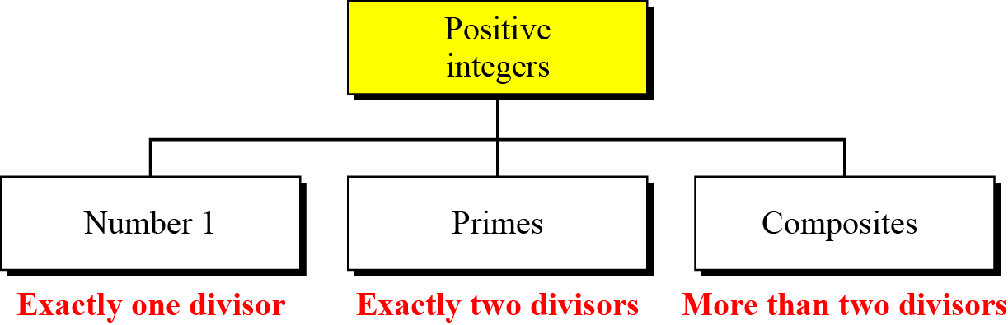
Primes
Three groups of positive integers
A prime is divisible only by itself and 1.
The smallest prime????

Slide 4
Checking for Primeness
Given a number n, how can we determine if n is a prime?
The answer is that we need to see if the number is divisible by primes less than √n
Is 97 a prime?
The floor of √97 = 9. The primes less than 9 are 2, 3, 5, and 7. We need to see if 97 is divisible by any of these numbers. It is not, so 97 is a prime.

Slide 5
Checking for Primeness(cont.)
Is 301 a prime?
The floor of √301 = 17. We need to check 2, 3, 5, 7, 11, and 13. The numbers 2, 3, and 5 do not divide 301, but 7 does. Therefore 301 is not a prime.

Slide 6
Generating Primes
Mersenne Primes-
If p in the above formula is a prime, then M_{p} was thought to be prime.
A number in the form M_{p} = 2^{p} − 1 is called a Mersenne number and may or may not be a prime.

Slide 7

Generating Primes(cont.)
Fermat Primes
F₀ = 3 F₁ = 5 F₂ = 17 F₃ = 257 F₄ = 65537
F₅ = 4294967297 = 641 × 6700417 Not a prime

Slide 8
Primality Testing
Finding an algorithm to correctly and efficiently test a very large integer and output a prime or a composite has always been a challenge in number theory.
Two types
Deterministic Algorithms <gives correct answer>
Probabilistic Algorithms <gives an answer that is correct most of the time, but not all of time>

Slide 9
Deterministic Algorithms
Divisibility Algorithm

Slide 10
Probabilistic Algorithms
Fermat Test
Example
Does the number 561 pass the Fermat test?
If n is a prime, a^{n−1} ≡ 1 mod n
If n is a composite, it is possible that a^{n−1} ≡ 1 mod n

Slide 11
Probabilistic Algorithms(cont.)
Example
Does the number 561 pass the Fermat test?
Solution
Use base 2
The number passes the Fermat test, but it is not a prime, because 561 = 33 × 17.

Slide 12
CHINESE REMAINDER THEOREM
Used to solve a set of congruent equations with one variable but different moduli, which are relatively prime
The above equations have a unique solution if the moduli are relatively prime

Slide 13
Continued…
Example
The following is an example of a set of equations with different moduli:
The solution to this set of equations is given in the next section; for the moment, note that the answer to this set of equations is x = 23. This value satisfies all equations: 23 ≡ 2 (mod 3), 23 ≡ 3 (mod 5), and 23 ≡ 2 (mod 7).

Slide 14
Continued…
Solution To Chinese Remainder Theorem
Find M = m₁ × m₂ × … × m_{k}. This is the common modulus.
Find M₁ = M/m₁, M₂ = M/m₂, …, M_{k} = M/m_{k}.
Find the multiplicative inverse of M₁, M₂, …, M_{k} using the corresponding moduli (m₁, m₂, …, m_{k}). Call the inverses M₁⁻¹, M₂⁻¹, …, M_{k} ⁻¹.
The solution to the simultaneous equations is

Slide 15
Continued…
Example
Find the solution to the simultaneous equations:
Solution: We follow the four steps.
1. M = 3 × 5 × 7 = 105
2. M₁ = 105 / 3 = 35, M₂ = 105 / 5 = 21, M₃ = 105 / 7 = 15
3. The inverses are M₁⁻¹ = 2, M₂⁻¹ = 1, M₃ ⁻¹ = 1
4. x = (2 × 35 × 2 + 3 × 21 × 1 + 2 × 15 × 1) mod 105 = 23 mod 105

Slide 16
Continued…
Example
Find an integer that has a remainder of 3 when divided by 7 and 13, but is divisible by 12.
Solution ????

Slide 17
Continued…
Example
Find an integer that has a remainder of 3 when divided by 7 and 13, but is divisible by 12.
Solution
This is a CRT problem. We can form three equations and solve them to find the value of x.
x ≡ 3 mod 7
x ≡ 3 mod 13
x ≡ 0 mod 12
If we follow the four steps, we find x = 276. We can check that 276 ≡ 3 mod 7, 276 ≡ 3 mod 13 and 276 is divisible by 12 (the quotient is 23 and the remainder is zero).

Slide 18
Continued…
Secret Sharing scheme in cryptography aims to distribute and later recover secret S among n parties. Secret S is distributed in form of shares which are generated from secret. Without cooperation of k no. of parties, the secret cannot be reconstructed from shares directly. Consider the following example:
Say our secret is S. The shares for n=4 no. of parties are generated taking modulus 11,13,17 and 19. They are respectively 1,12,2 and 3 and given by following equations:
S Ξ 1 mod 11,
S Ξ 12 mod 13,
S Ξ 2 mod 17,
S Ξ 3 mod 19.
Now, from four possible sets of k=3 shares (as k shares are necessary to reconstruct the secret), consider one possible set {1, 12, 2} and recover the secret S from it.

Slide 19
Continued…
Solution: The problem can be solved by Chinese remainder theorem. For the set {1,12,2}, the equations available are, S Ξ 1 mod 11, S Ξ 12 mod 13, S Ξ 2 mod 17, Now solving this equation using CRT, M=11 *13*17 = 2431, M1 = 2431/11=221, M2 = 2431/13=187, M3=2431/17=143 M1⁻¹ , M2⁻¹ and M3⁻¹ can be calculated using Extended Euclidean Algorithm. M1⁻¹ = 1 M2⁻¹ = 8 M3⁻¹= 5 Now, secret S= ((1*221*1) + (12*187*8) + (2*143*5)) mod 2431 S = 155 mod 2431

Slide 20
EXPONENTIATION AND LOGARITHM

Slide 21
EXPONENTIATION AND LOGARITHM
Exponentiation and logarithm are inverses of each other.
a is called the base of the exponentiation or logarithm

Slide 22
EXPONENTIATION
In cryptography, a common modular operation is exponentiation. That is we often need to calculate.
y = a^{x} mod n
The RSA cryptosystem, which uses exponentiation for both encryption and decryption with very large exponents.
Unfortunately, most computer languages have no operator that can efficiently compute exponentiation, particularly when the exponent is very large.
To make this type of calculation, we need more efficient algorithms.

Slide 23
EXPONENTIATION
Fast Exponentiation
The idea behind the square-and-multiply method
In traditional algorithms only multiplication is used to simulate exponentiation, but the fast exponentiation uses both squaring and multiplication.
square-and-multiply method - treat the exponent as a binary number of n_{b} bits (x₀ to x_{nb-1})

Slide 24
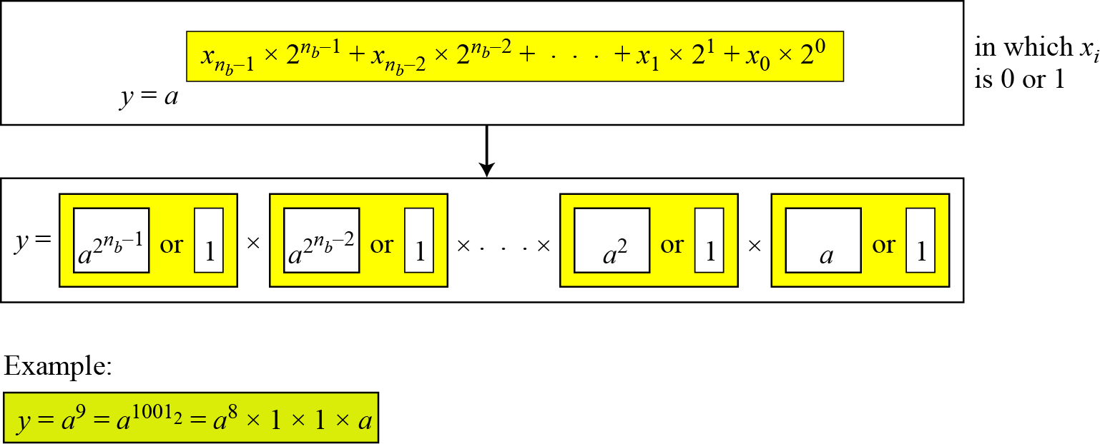
Exponentiation
Fast Exponentiation
The idea behind the square-and-multiply method

Slide 25
Continued…

Slide 26
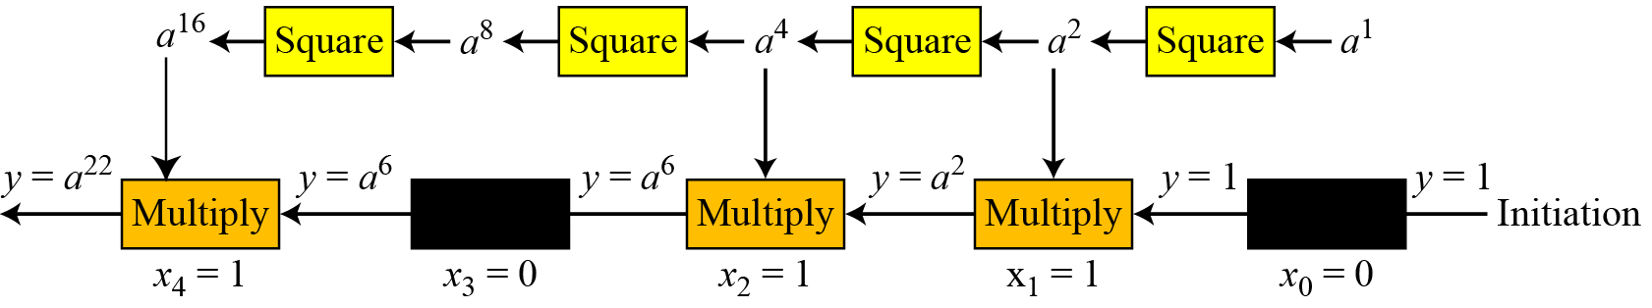
Continued…
The process for calculating y = a^{x}
In this case, x = 22 = (10110)₂ in binary.

Slide 27
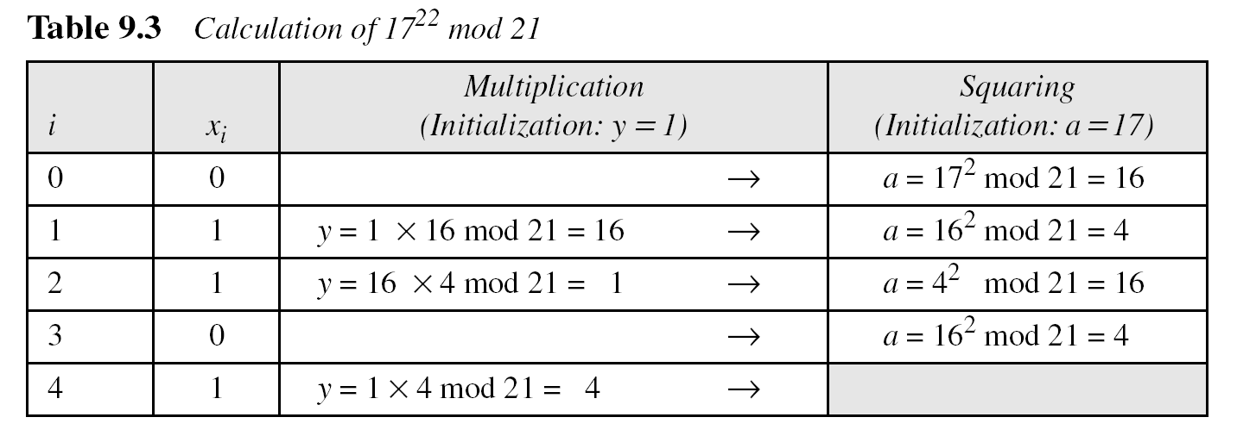
Continued…

Slide 28
Logarithm
In cryptography we need to discuss modular logarithm.
If we use exponentiation to encrypt or decrypt, the adversary can use logarithm to attack.
We need to know how hard it is to reverse the exponentiation.

Slide 29
Logarithm(cont.)
Order of the Group.
Example:
What is the order of group G = <Z₂₁∗, ×>?
|G| = φ (21) = φ (3) × φ (7) = 2 × 6 =12. There are 12 elements in this group: 1, 2, 4, 5, 8, 10, 11, 13, 16, 17, 19, and 20. All are relatively prime with 21.

Slide 30
Logarithm(cont.)
Order of an element: The order of an element is the order of the cyclic group it generates.
Example:
Find the order of all elements in G = <Z₁₀∗, ×>.
This group has only φ(10) = 4 elements: 1, 3, 7, 9.
Lagrange Theorem- The order of an element divides the order of the group. The only integers that divide 4 are 1, 2, and 4, which means in each case we need to check only these powers to find the order of the element.
a. 1¹ ≡ 1 mod (10) → ord(1) = 1.
b. 3⁴ ≡ 1 mod (10) → ord(3) = 4.
c. 7⁴ ≡ 1 mod (10) → ord(7) = 4.
d. 9² ≡ 1 mod (10) → ord(9) = 2.

Slide 31
Logarithm(cont.)
Primitive roots
In the group G = <Z_{n}∗, ×>, when the order of an element is the same as φ(n), that element is called the primitive root of the group.
Example
There are no primitive roots in G = <Z₈∗, ×> because no element has the order equal to φ(8) = 4.

Slide 32
Logarithm(cont.)
Example
the result of a^{i} ≡ x (mod 7) for the group G = <Z₇∗, ×>. In this group, φ(7) = 6.

Slide 33
Logarithm(cont.)
The group G = <Z_{n}*, ×> has primitive roots only if n is 2, 4, p^{t}, or 2p^{t}. <p is an odd prime (not 2) and t is an integer>
For which value of n, does the group G = <Z_{n}∗, ×> have primitive roots: 17, 20, 38, and 50?
Solution
G = <Z₁₇∗, ×> has primitive roots, 17 is a prime.
b. G = <Z₂₀∗, ×> has no primitive roots.
c. G = <Z₃₈∗, ×> has primitive roots, 38 = 2 × 19 prime.
d. G = <Z₅₀∗, ×> has primitive roots, 50 = 2 × 5² and 5 is a prime.

Slide 34
Logarithm(cont.)
If the group G = <Z_{n}*, ×> has any primitive root, the number of primitive roots is φ(φ(n)).
Cyclic Group If g is a primitive root in the group, we can generate the set Z_{n}* as Z_{n}∗ = {g¹, g², g³, …, g^{φ(n)}}
The group G = <Z₁₀*, ×> has two primitive roots because φ(10) = 4 and φ(φ(10)) = 2. It can be found that the primitive roots are 3 and 7. The following shows how we can create the whole set Z₁₀* using each primitive root.

Slide 35
Logarithm(cont.)
The idea of Discrete Logarithm
Properties of G = <Z_{p}*, ×> :
1. Its elements include all integers from 1 to p − 1.
2. It always has primitive roots.
3. It is cyclic. The elements can be created using g^{x} where x is an integer from 1 to φ(n) = p − 1.
4. The primitive roots can be thought as the base of logarithm.

Slide 36
Logarithm(cont.)
Solution to Modular Logarithm Using Discrete Logs
Tabulation of Discrete Logarithms

Slide 37
Logarithm(cont.)
Find x in each of the following cases:
a. 4 = 3^{x} (mod 7).
b. 6 = 5^{x} (mod 7).
Solution
We can easily use the tabulation of the discrete logarithm:
a. 4 = 3^{x} mod 7 → x = L₃4 mod 7 = 4 mod 7
b. 6 = 5^{x} mod 7 → x = L₅6 mod 7 = 3 mod 7

